Slide 1
Self-Made Billionaire Culture
By: Stephen Giang & Nataly Nguyen

Slide 2
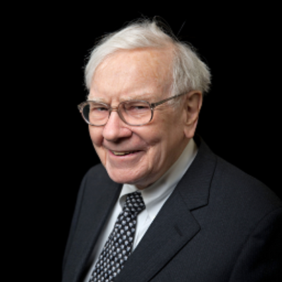
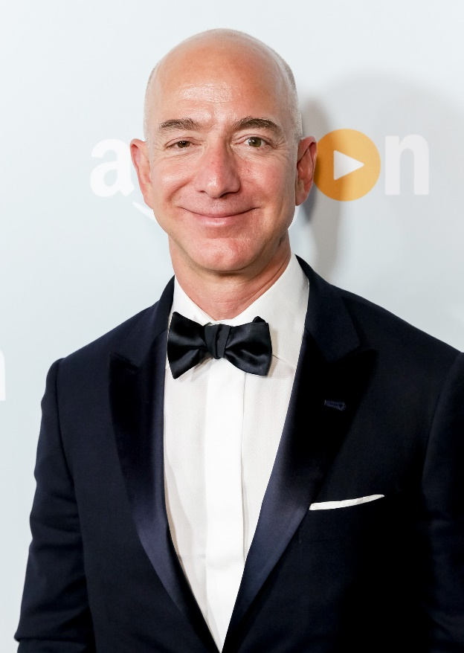
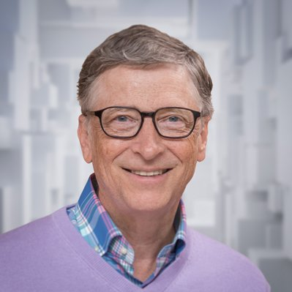
TOP 3
84.9 Billion
98.4 Billion
143.7 Billion

Slide 3
What are your odds?

Slide 4

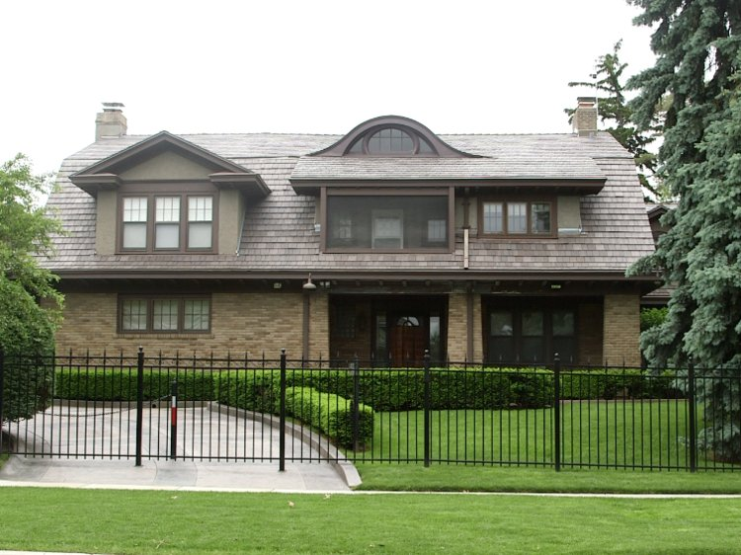
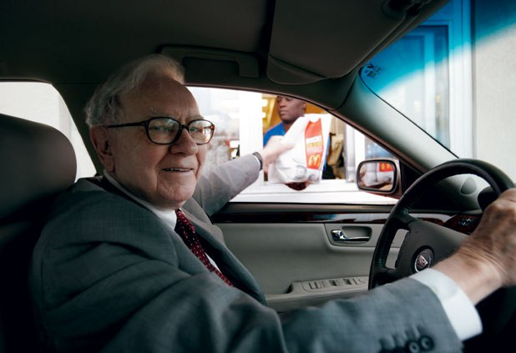

Warren Buffett Spending

Slide 5
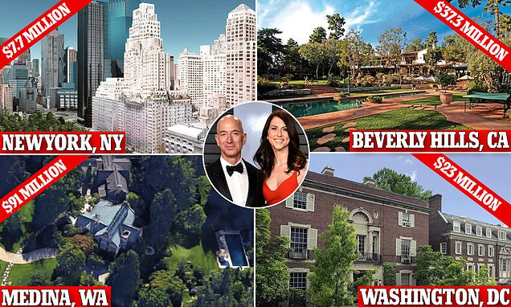
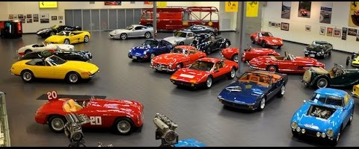
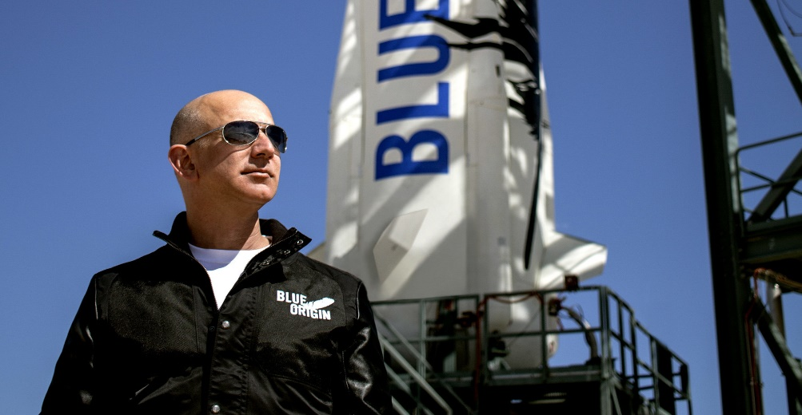


Luxuries of Billions

Slide 6
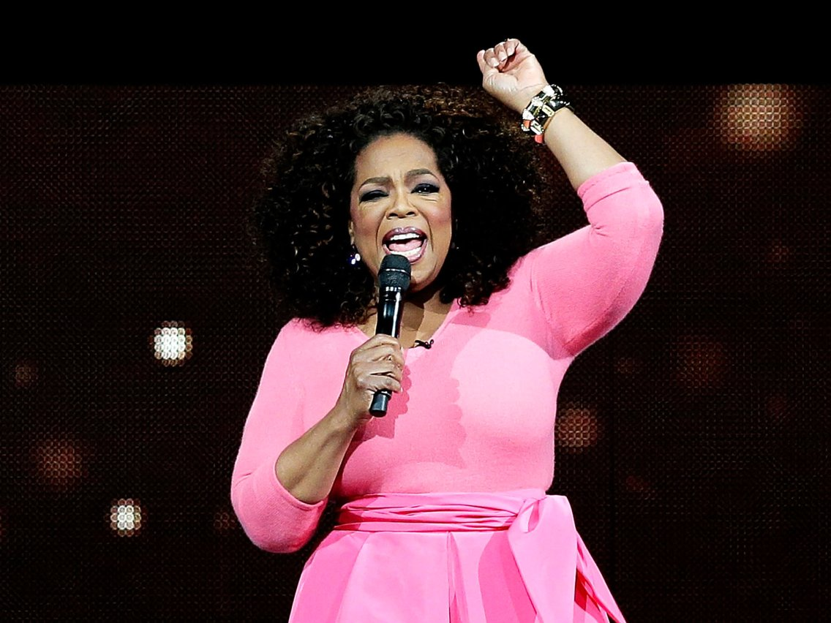
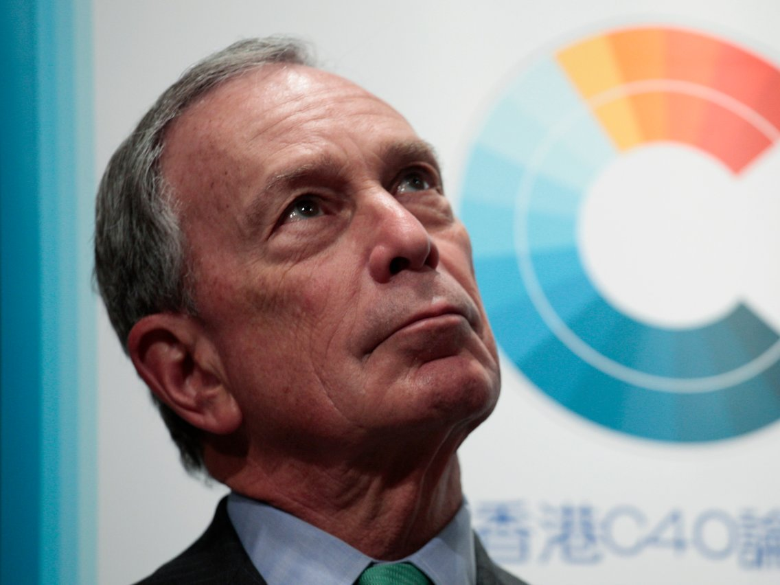
How Billionaires Value Money
"The reason I've been able to be so financially successful is my focus has never, ever for one minute been money."
“I think the more money you put in people’s hands, the more they will spend. And if they don’t spend it, they invest it. And investing is another way of creating jobs. It puts money into mutual funds or other kinds of banks that can go out and make loans, and we need to do that”.

Slide 7
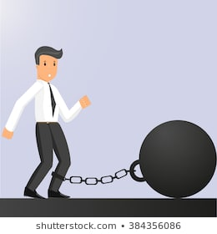

The Downsides
“RICH GUY”

Slide 8


Conclusion

